Slide 1

Chapter 3
Data Modeling Using the Entity-Relationship (ER) Model

Slide 2
Chapter Outline
Example Database Application (COMPANY)
ER entitiy relationship Model Concepts
  Entities and Attributes
  Entity Types, Value Sets, and Key Attributes
  Relationships and Relationship Types
  Weak Entity Types
  Roles and Attributes in Relationship Types
ER Diagrams - Notation
ER Diagram for COMPANY Schema
Alternative Notations – UML class diagrams, others

Slide 3
ER Model Concepts
Entities and Attributes
  Entities are specific objects or things in the field that are represented in the database. For example the EMPLOYEE John Smith, the Research DEPARTMENT, the ProductX PROJECT
  Attributes are properties used to describe an entity. For example an EMPLOYEE entity may have a Name, SSN, Address, Sex, BirthDate
  A specific entity will have a value for each of its attributes. For example a specific employee entity may have Name='John Smith', SSN='123456789', Address ='731, Fondren, Houston, TX', Sex='M', BirthDate='09-JAN-55‘
  Each attribute has a value set (or data type) associated with it – e.g. integer, string, subrange, enumerated type, …

Slide 4
Types of Attributes
Simple
  Each entity has a single atomic value for the attribute. For example, SSN or Sex.
Composite
  The attribute may be composed of several components. For example, Address (Apt#, House#, Street, City, State, ZipCode, Country) or Name (FirstName, MiddleName, LastName). Composition may form a hierarchy where some components are themselves composite.
Multi-valued
  An entity may have multiple values for that attribute. For example, Color of a CAR or PreviousDegrees of a STUDENT. Denoted as {Color} or {PreviousDegrees}.

Slide 5
Entity Types and Key Attributes
Entities with the same basic attributes are grouped or typed into an entity type. For example, the EMPLOYEE entity type or the PROJECT entity type.
An attribute of an entity type for which each entity must have a unique value is called a key attribute of the entity type. For example, SSN of EMPLOYEE.
A key attribute may be composite. For example, VehicleTagNumber is a key of the CAR entity type with components (Number, State)

Slide 6
Example COMPANY Database
Requirements of the Company:
  The company is organized into DEPARTMENTs. Each department has multiple locations, a name, number and an employee who manages the department. We keep track of the start date of the department manager.
  Each department controls a number of PROJECTs. Each project has a name, number and is located at a single location.

Slide 7
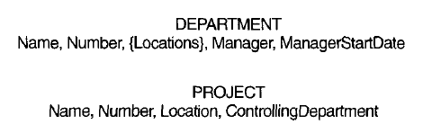
Preliminary design of entity types for the COMPANY database

Slide 8
Example COMPANY Database (Requirements Cont.)
  We store each EMPLOYEE’s social security number, address, salary, sex, and birthdate. Each employee works for one department but may work on several projects. We keep track of the number of hours per week that an employee currently works on each project. We also keep track of the direct supervisor of each employee.
  Each employee may have a number of DEPENDENTs. For each dependent, we keep track of their name, sex, birthdate, and relationship to employee.

Slide 9
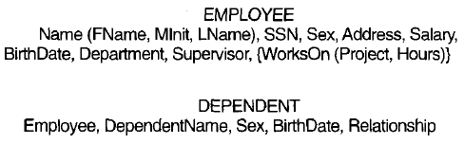
Preliminary design of entity types for the COMPANY database – cont.

Slide 10
Relationships and Relationship Types (1)
A relationship relates two or more distinct entities with a specific meaning. For example, EMPLOYEE John Smith works on the ProductX PROJECT or EMPLOYEE Franklin Wong manages the Research DEPARTMENT.
Relationships of the same type are grouped or typed into a relationship type. For example, the WORKS_ON relationship type in which EMPLOYEEs and PROJECTs participate, or the MANAGES relationship type in which EMPLOYEEs and DEPARTMENTs participate.
The degree of a relationship type is the number of participating entity types. Both MANAGES and WORKS_ON are binary relationships.

Slide 11
Example relationship instances of the WORKS_FOR relationship between EMPLOYEE and DEPARTMENT
EMPLOYEE
WORKS_FOR
DEPARTMENT
e_{1 }
e_{2 }
e_{3 }
e_{4 }
e_{5 }
e_{6 }
e_{7 }
r₁
r₂
r₃
r₄
r₅
r₆
r₇
● d₁
● d₂
● d₃

Slide 12
Example relationship instances of the WORKS_ON relationship between EMPLOYEE and PROJECT
EMPLOYEE
WORKS_ON
PROJECT
e_{1 }
e_{2 }
e_{3 }
e_{4 }
e_{5 }
e_{6 }
e_{7 }
r₉
r₁
r₂
r₃
r₄
r₅
r₆
r₇
● p₁
● p₂
● p₃
r₈

Slide 13
Relationships and Relationship Types (2)
More than one relationship type can exist with the same participating entity types. For example, MANAGES and WORKS_FOR are distinct relationships between EMPLOYEE and DEPARTMENT, but with different meanings and different relationship instances.

Slide 14
Constraints on Relationships
Constraints on Relationship Types
  ( Also known as ratio constraints )
  Maximum Cardinality
    One-to-one (1:1)
    One-to-many (1:N) or Many-to-one (N:1)
    Many-to-many
  Minimum Cardinality (also called participation constraint or existence dependency constraints)
    zero (optional participation, not existence-dependent)
    one or more (mandatory, existence-dependent)

Slide 15
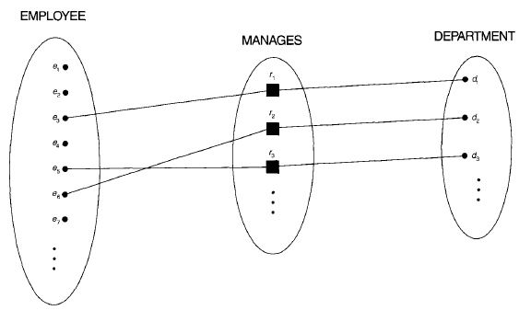
One-to-one (1:1) RELATIONSHIP

Slide 16
Many-to-one (N:1) RELATIONSHIP
EMPLOYEE
WORKS_FOR
DEPARTMENT
e_{1 }
e_{2 }
e_{3 }
e_{4 }
e_{5 }
e_{6 }
e_{7 }
r₁
r₂
r₃
r₄
r₅
r₆
r₇
● d₁
● d₂
● d₃

Slide 17
Many-to-many (M:N) RELATIONSHIP
EMPLOYEE
WORKS_ON
PROJECT
e_{1 }
e_{2 }
e_{3 }
e_{4 }
e_{5 }
e_{6 }
e_{7 }
r₉
r₁
r₂
r₃
r₄
r₅
r₆
r₇
● p₁
● p₂
● p₃
r₈

Slide 18
Relationships and Relationship Types (3)
We can also have a recursive relationship type.
Both participations are same entity type in different roles.
For example, SUPERVISION relationships between EMPLOYEE (in role of supervisor or boss) and (another) EMPLOYEE (in role of subordinate or worker).
In following figure, first role participation labeled with 1 and second role participation labeled with 2.
In ER diagram, need to display role names to distinguish participations.

Slide 19
A RECURSIVE RELATIONSHIP
SUPERVISION
EMPLOYEE
SUPERVISION
e_{1 }
e_{2 }
e_{3 }
e_{4 }
e_{5 }
e_{6 }
e_{7 }
r₁
r₂
r₃
r₄
r₅
r₆
2
1
1
2
2
1
2
1
1
2
1
2

Slide 20
Weak Entity Types
An entity that does not have a key attribute
A weak entity must participate in an identifying relationship type with an owner or identifying entity type
Entities are identified by the combination of:
  A partial key of the weak entity type
  The particular entity they are related to in the identifying entity type
Example:
Suppose that a DEPENDENT entity is identified by the dependent’s first name and birhtdate, and the specific EMPLOYEE that the dependent is related to. DEPENDENT is a weak entity type with EMPLOYEE as its identifying entity type via the identifying relationship type DEPENDENT_OF

Slide 21
SUMMARY OF ER-DIAGRAM
NOTATION FOR ER SCHEMAS
Symbol
Meaning
ENTITY TYPE
WEAK ENTITY TYPE
RELATIONSHIP TYPE
IDENTIFYING RELATIONSHIP TYPE
ATTRIBUTE
KEY ATTRIBUTE
MULTIVALUED ATTRIBUTE
COMPOSITE ATTRIBUTE
DERIVED ATTRIBUTE
TOTAL PARTICIPATION OF E₂ IN R
CARDINALITY RATIO 1:N FOR E₁:E₂ IN R
STRUCTURAL CONSTRAINT (min, max) ON PARTICIPATION OF E IN R
E₁
R
E₂
E₁
R
N
E₂
R
(min,max)
E

Slide 22
Attributes of Relationship types
A relationship type can have attributes; for example, HoursPerWeek of WORKS_ON; its value for each relationship instance describes the number of hours per week that an EMPLOYEE works on a PROJECT.

Slide 23
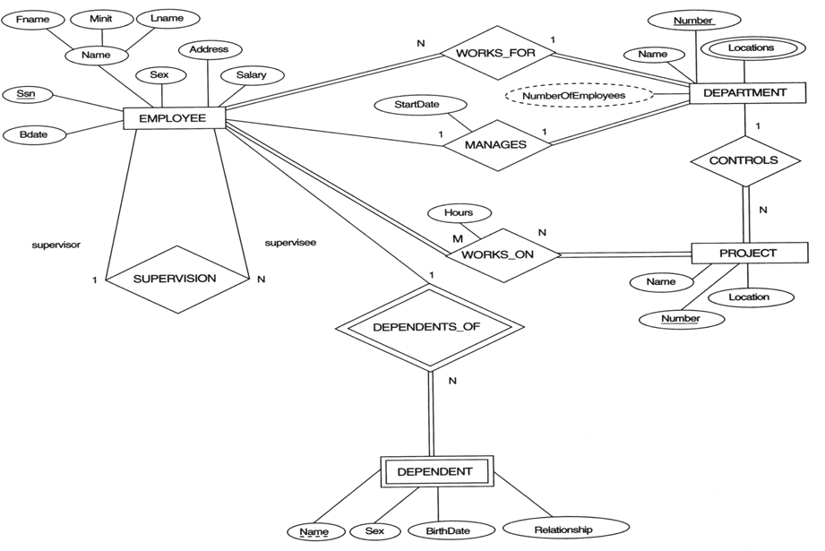
COMPANY ER DIAGRAM

Slide 24
COMPANY ER DIAGRAM Notes
Relationship Types are:
WORKS_FOR, MANAGES, WORKS_ON, CONTROLS,
SUPERVISION, DEPENDENTS_OF
Weak Entity Type is: DEPENDENT
Identifying Relationship is: DEPENDENTS_OF
Recursive Relationship Type is: SUPERVISION
Attribute of a Relationship Type is:
Hours of WORKS_ON

Slide 25
Structural Constraints – one way to express semantics of relationships
Structural constraints on relationships:
Cardinality ratio (of a binary relationship): 1:1, 1:N, N:1, or M:N
  SHOWN BY PLACING APPROPRIATE NUMBER ON THE LINK.
Participation constraint (on each participating entity type): total (called existence dependency) or partial.
SHOWN BY DOUBLE LINING THE LINK
NOTE: These are easy to specify for Binary Relationship Types.

Slide 26
Relationships of Higher Degree
Relationship types of degree 2 are called binary
Relationship types of degree 3 are called ternary and of degree n are called n-ary
In general, an n-ary relationship is not equivalent to n binary relationships
Higher-order relationships discussed further in Chapter 4

Slide 27
Some of the Currently Available Automated Database
Design Tools
COMPANY | TOOL | FUNCTIONALITY
Embarcadero Technologies | ER Studio | Database Modeling in ER and IDEF1X
 | DB Artisan | Database administration and space and security management
Oracle | Developer 2000 and Designer 2000 | Database modeling, application development
Popkin Software | System Architect 2001 | Data modeling, object modeling, process modeling, structured analysis/design
Platinum Technology | Platinum Enterprice Modeling Suite: Erwin, BPWin, Paradigm Plus | Data, process, and business component modeling
Persistence Inc. | Pwertier | Mapping from O-O to relational model
Rational | Rational Rose | Modeling in UML and application generation in C++ and JAVA
Rogue Ware | RW Metro | Mapping from O-O to relational model
Resolution Ltd. | Xcase | Conceptual modeling up to code maintenance
Sybase | Enterprise Application Suite | Data modeling, business logic modeling
Visio | Visio Enterprise | Data modeling, design and reengineering Visual Basic and Visual C++

Slide 28
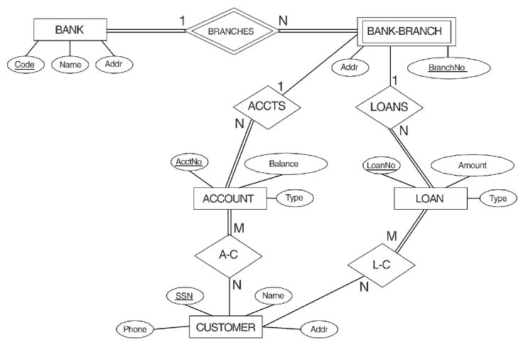
ER DIAGRAM FOR A BANK
DATABASE

Slide 29
Basic Entity-Relationship Exercises

Slide 30
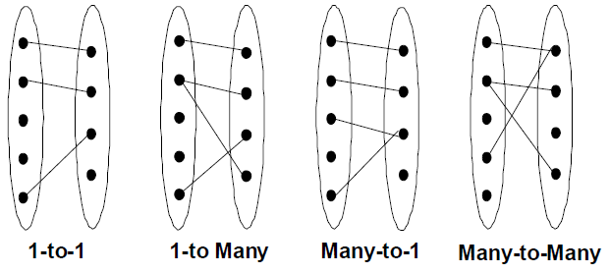
Review: Relationship Cardinalities

Slide 31
Basic Steps for Designing an Entity-Relationship Diagram
Define entity types
Define attributes and keys
Define relationship types and cardinalities

Slide 32
Examples: Draw ER diagrams for the following business rules:
Every department is managed by one employee. An employee can manage at most one department. Some employees do not manage departments.
Every car has at least one owner. One person may own several cars or no cars.
Each lecturer is given at most one typist secretary. A typist may be secretary for many or zero lecturers.
Each room is owned by one department. A department owns at least one room.

Slide 33
Exercise 1: Mail Order database
The mail order company has:
Employees: for each employee it keeps a unique ID number, first last names, and a date of birth.
• Customers: for each customer it keeps a unique ID number, first and last names, multiple phone numbers, and a location where they are located.
• Used parts being sold by the company: it keeps a unique part number, part name, and price.
Orders: each order is placed by one customer, and must have one or more parts. A customer may or may not place one or more order. An order is taken by at least one employee. A unique order number, order date, and shipped date are recorded. Each part can be ordered only once.

Slide 34
Exercise 2: movies database
Movies are identified by their title and year of release. They have a length in minutes. They also have a studio that produces the movie and are classified under one type (such as horror, action, drama, etc). Movies are directed by one or more directors and have one or more actors.
Actors are identified by their names and date of birth and act in one or more movies. Each actor has a role in the movie.
Directors are also identified by their names and date of birth. Each director has a rank value and direct one or more movies.
Studios are identified by their names and have an address. The address contains building number, street name, and city name. They produce one or more movies.

Slide 35
Exercise 3: school system
Each subject is owned by a department and each department is managed by a teacher, called Head of Department (HOD). Each department has a name and a unique code number. Each subject has a name, unique number and credit value. All teachers have a unique ID. A HOD cannot manage more than one department at a time. Also, a HOD does not teach subjects. A subject cannot be taught by more than one teacher. Finally, the system needs to know each student’s contact details, including, full name, student ID, address, age and gender, as well as date of enrolment in the subject.

Slide 36
PROBLEM with ER notation
THE ENTITY RELATIONSHIP MODEL IN ITS ORIGINAL FORM DID NOT SUPPORT THE SPECIALIZATION/ GENERALIZATION ABSTRACTIONS

Slide 37
Extended Entity-Relationship (EER) Model
Incorporates Set-subset relationships
Incorporates Specialization/Generalization Hierarchies
NEXT CHAPTER ILLUSTRATES HOW THE ER MODEL CAN BE EXTENDED WITH
- Set-subset relationships and Specialization/Generalization Hierarchies and how to display them in EER diagrams

